Slide 1
SITA1503
FOG AND CLOUD COMPUTING
Unit 1

Slide 2

Cloud Computing

Slide 3
UNIT 1 UNDERSTANDING CLOUD COMPUTING
Basic Concepts and Terminology - Cloud Computing Architectural Framework - Types of Clouds - pros and cons of
cloud computing –
Cloud
Characteristics - difference
between web 2.0 and
cloud - key challenges in cloud
computing - Major Cloud players - Virtualization in Cloud Computing - Parallelization in Cloud Computing - cloud resource management – Cloud Enabling Technology.

Slide 4
History of Cloud Computing
Before emerging the cloud computing, there was Client/Server computing which is basically a centralized storage in which all the software applications, all the data and all the controls are resided on the server side.
If a single user wants to access specific data or run a program, he/she need to connect to the server and then gain appropriate access, and then he/she can do his/her business.
Then after, distributed computing came into picture, where all the
computers are networked together and share their resources when needed.
On the basis of above computing, there was emerged of cloud computing
concepts that later implemented.

Slide 5
History of Cloud Computing
At around in 1961, John MacCharty suggested in a speech at MIT that computing can be sold like a utility, just like a water or electricity
In 1999, Salesforce.com started delivering of applications to users using a simple website. The applications were delivered to enterprises over the Internet, and this way the dream of computing sold as utility were true.

Slide 6
History of Cloud Computing
In 2002, Amazon started Amazon Web Services, providing services like storage, computation and even human intelligence. However, only starting with the launch of the Elastic Compute Cloud in 2006 a truly commercial service open to everybody existed.

Slide 7
History of Cloud Computing
In 2009, Google Apps also started to provide cloud
computing enterprise applications.
Same year Microsoft launched Windows Azure, and
companies like Oracle and HP have all joined the game. This proves that today, cloud computing has become mainstream.

Slide 8
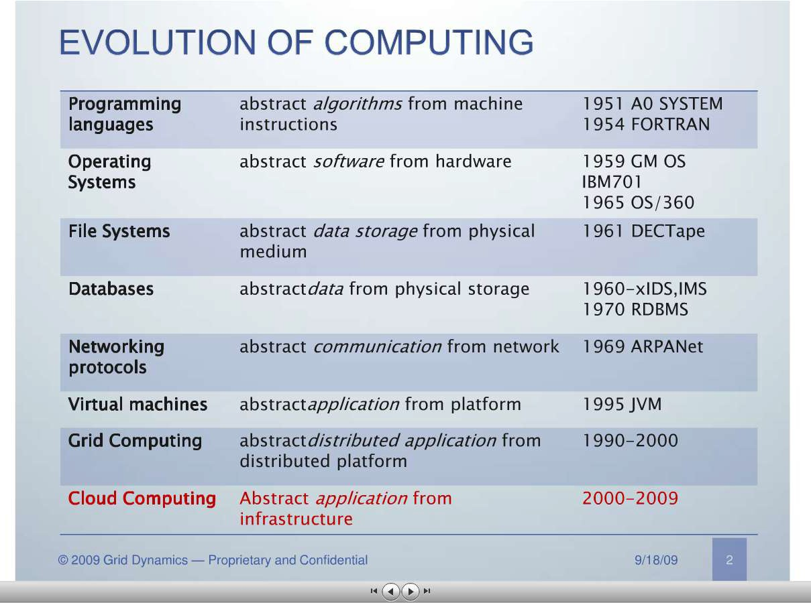

Slide 9
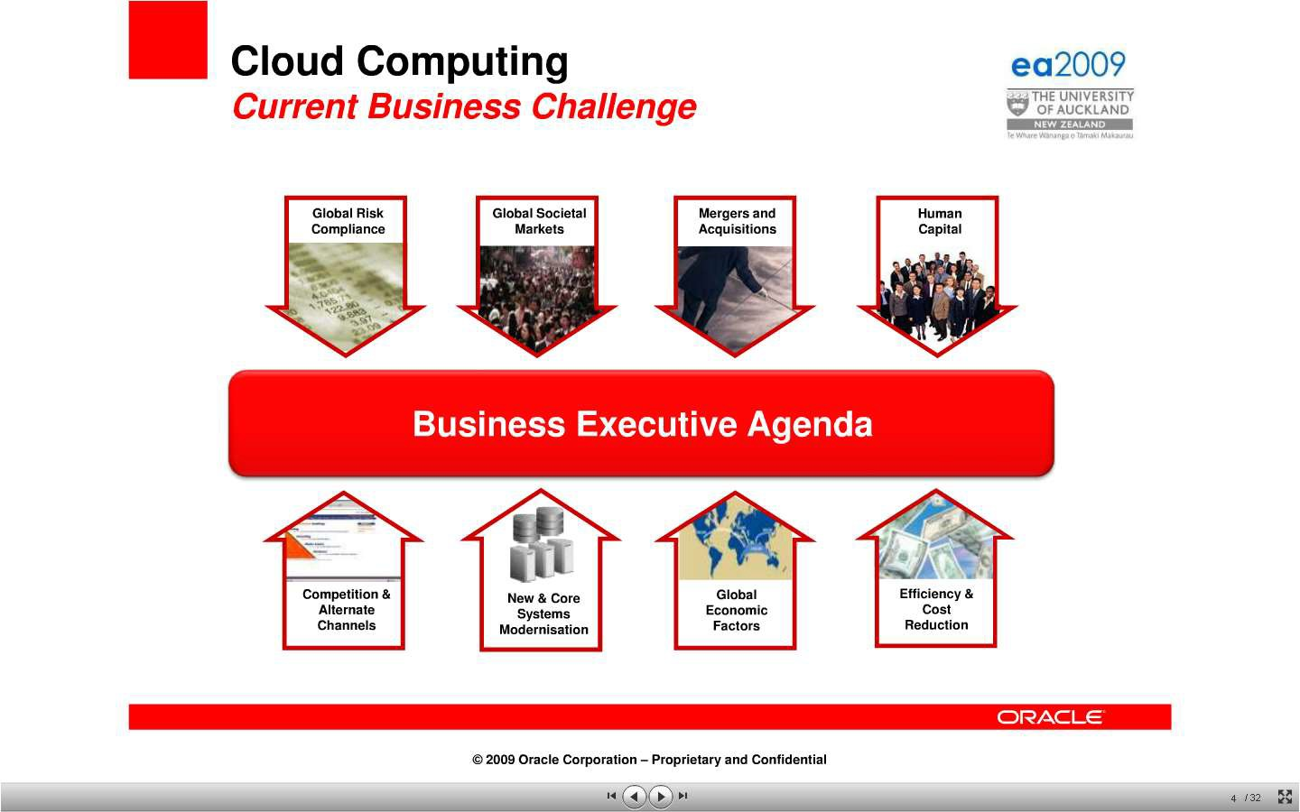
http://www.slideshare.net/marccaltabiano/ea2009-enterprise-architecture-keynote

Slide 10
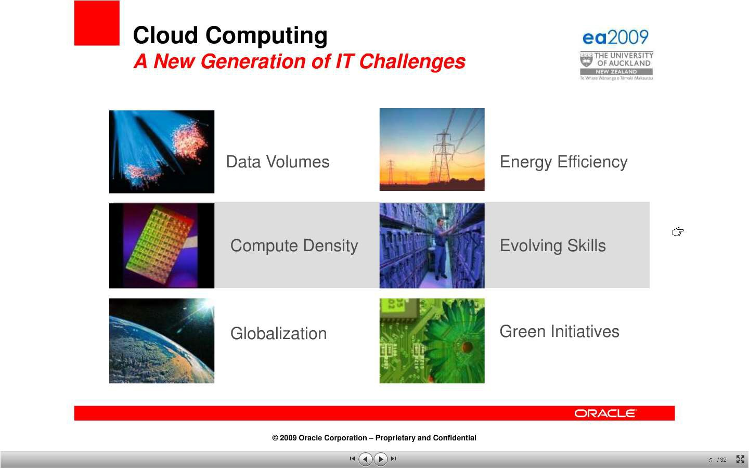

Slide 11
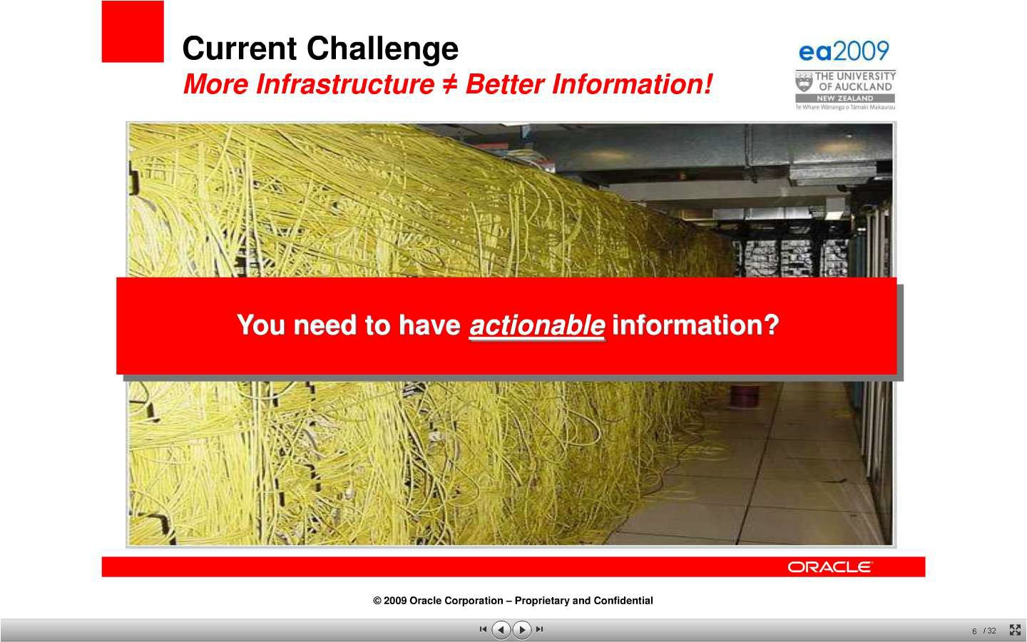

Slide 12
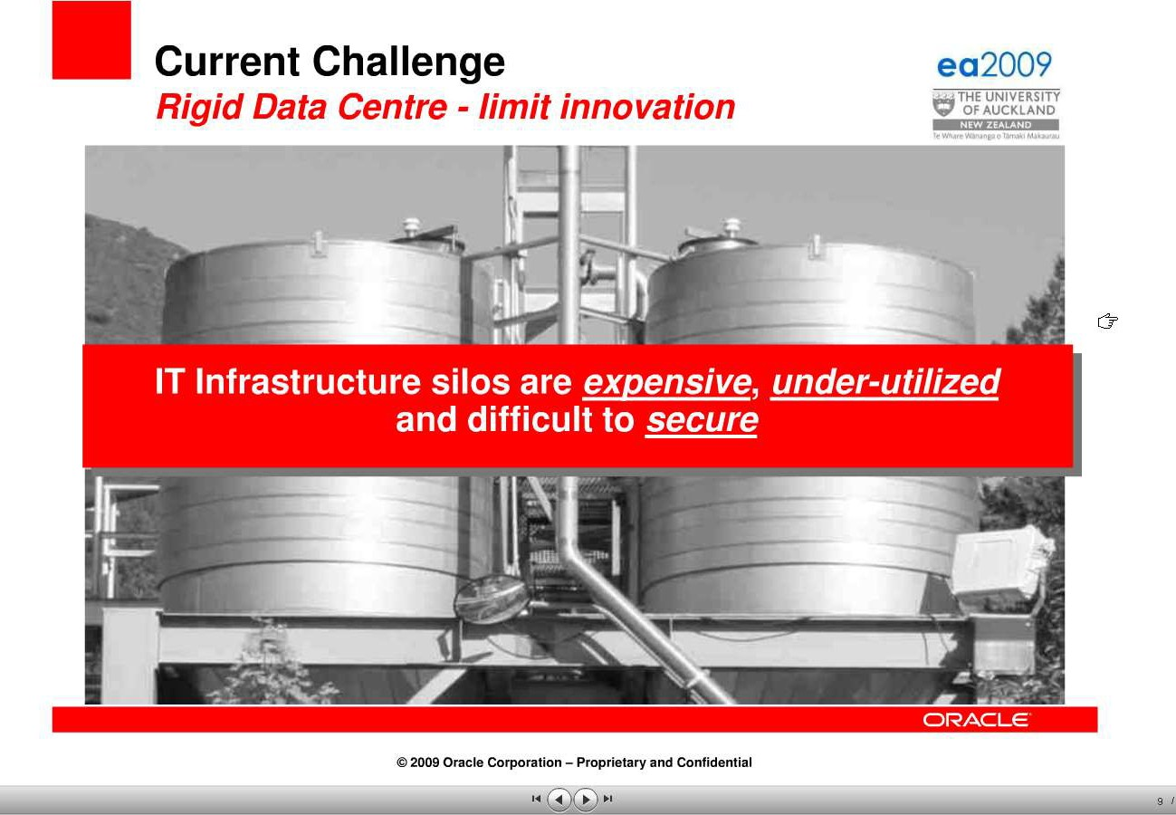

Slide 13
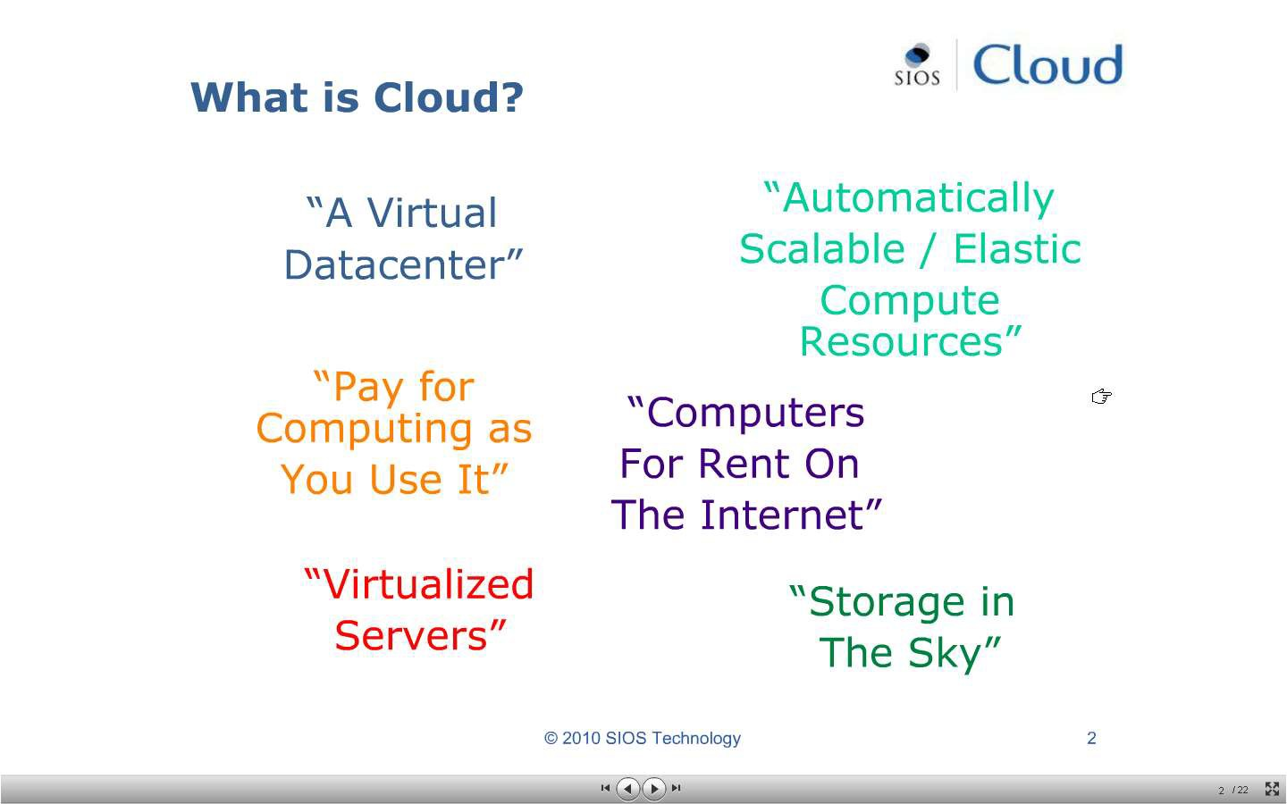

Slide 14

What is ?
Cloud computing is a technology that uses the internet and central remote servers to maintain data and applications.
A simple example of cloud computing is Yahoo email or Gmail etc,.

Slide 15
CLOUD COMPUTING:DEFENITION
Cloud computing means on demand delivery of IT resources via the internet with pay-as-you- go pricing. It provides a solution of IT infrastructure in low cost.

Slide 16
A style of computing where massively scalable (and elastic) IT-related capabilities are
provided “as a service” to external customers using Internet technologies.

Slide 17
The analogy is , 'If you only need milk , would you buy a cow ?' All the users or consumers need is to get the benefits of using the software or hardware of the computer like sending emails etc. Just to get this benefit (milk) why should a consumer buy a (cow) software /hardware ?

Slide 18
Cloud computing is broken down into three segments:
"applications,“
"platforms," and
"infrastructure."

Slide 19
Cloud Computing Segments
Applications: It's all On Demand
On Demand software services
Who is Offering On Demand Software?
International Business Machines (IBM)
Salesforce.com (CRM)
EfroTech.com (HRIS)
Google (GOOG)
NetSuite (N)
Cordys
Taleo (TLEO)
Concur Technologies (CNQR)

Slide 20
Cloud Computing Segments
Platforms
allow users to access applications from centralized servers using the internet.
Active platforms -
International Business Machines (IBM) - IBM Cloud - Lotus Live
Google (GOOG) - Apps Engine
Amazon.com (AMZN) - EC2
Microsoft (MSFT) - Windows Azure
Logicworks (www.logicworks.net) - infiniCloud
SAVVIS (SVVS) - Symphony VPDC
Terremark Worldwide (TMRK) - The Enterprise Cloud
Salesforce.com (CRM) - Force.com
NetSuite (N) - Suiteflex
Rackspace Cloud - cloudservers, cloudsites, cloudfiles
[http://www.metrisoft.com Metrisoft

Slide 21
Cloud Computing Segments
Infrastructure
allow users to build applications
Major Infrastructure Vendors
Google (GOOG) - Managed hosting, development environment
International Business Machines (IBM) - Managed hosting
SAVVIS (SVVS) - Managed hosting & cloud computing
Terremark Worldwide (TMRK) - Managed hosting
Amazon.com (AMZN) - Cloud storage
Rackspace Hosting (RAX) - Managed hosting & cloud
computing

Slide 22
X as a Service
"X as a Service" or "Anything as a Service " or "Everything as a Service. “
XaaS encompasses
SaaS (Software as a Service),
PaaS (Platform as a Service),
IaaS (Infrastructure as a Service),
HaaS (Hardware as a Service),
MaaS (Management as a Service),
CaaS (Communications as a Service) or
DaaS (Data or Database or Desktop as a Service).
Unified public + private (on-premises) cloud + Military grade security + full Data Control
+ Breakthrough workforce efficiency (http://www.xaas.com/)

Slide 23
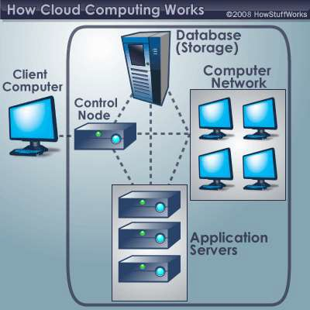
A typical cloud computing system
the front end
Dr.Kª.^{n}As^{d}hok kumar, Asso.Profess^{t}o^{h}r,^{e}C^{b}SEª, S^{c}I^{k}ST ^{end.}
http://computer.howstuffworks.com/cloud-computing1.htm

Slide 24
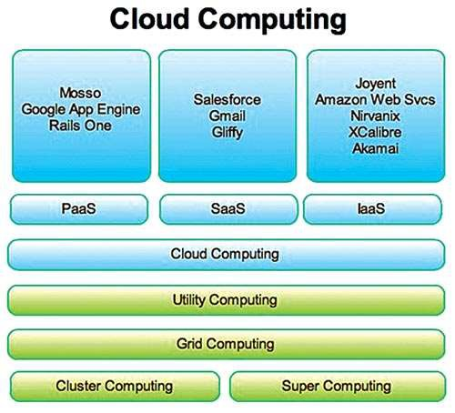

Slide 25
NEED OF CLOUD COMPUTING
Small as well as some large IT companies follows the traditional methods to provide the IT infrastructure
In their server room, there should be a database server, mail server, networking, firewalls, routers, modem, switches, QPS (Query Per Second means how much queries or load will be handled by the server) , configurable system, high net speed and the maintenance engineers.
To establish such IT infrastructure, we need to spend lots of money. To overcome all these problems and to reduce the IT infrastructure cost, Cloud Computing comes into existence.

Slide 26
Characteristics of Cloud Computing
Agility
- The cloud works in the distributed computing environment. It shares resources among users and works very fast.
High availability and reliability
- Availability of servers is high and more reliable, because chances of infrastructure failure are minimal.

Slide 27
Characteristics of Cloud Computing
High Scalability
- Means "on-demand" provisioning of resources on a large scale, without having engineers for peak loads.
Multi-Sharing
- With the help of cloud computing, multiple users and applications can work more efficiently with cost reductions by sharing common infrastructure.

Slide 28
Characteristics of Cloud Computing
Device and Location Independence
- Cloud computing enables the users to access systems using a web browser regardless of their location or what device they use e.g. PC, mobile phone etc. As infrastructure is off-site (typically provided by a third-party) and accessed via the Internet, users can connect from anywhere.

Slide 29
Characteristics of Cloud Computing
Maintenance
- Maintenance of cloud computing applications is easier, since they do not need to be installed on each user's computer and can be accessed from different places. So, it reduces the cost also.
Low Cost
- By using cloud computing, the cost will be reduced because to take the services of cloud computing, IT company need not to set its own infrastructure and pay-as-per usage of resources.

Slide 30
Characteristics of Cloud Computing
Services in pay-per-use mode
-Application Programming Interfaces (APIs) are provided to the users so that they can access services on the cloud by using these APIs and pay the charges as per the usage of services.

Slide 31
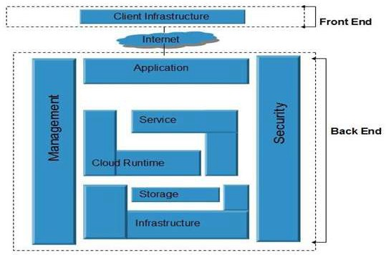
Architectural framework:

Slide 32
Components of Cloud Computing Architecture
A front-end platform that can include fat clients, thin clients, and mobile devices
Back-end platforms, such as servers and storage
Cloud-based delivery
A network (internet, intranet)

Slide 33
Front End and Back End Cloud Computing
At its most basic, cloud architecture can be classified into two sections: front-end and back-end, connected to each other via a virtual network or the internet.
There are other parts of cloud architecture including middleware, cloud
resources, etc., but for now we’ll just review the basics.
Front End Cloud Computing
Front-end is the side that is visible to the client, customer, or user. Front-end pieces include the user interface, and the client’s computer system or network that is used for accessing the cloud system. You have probably noticed that different cloud computing systems use different user interfaces—for example, not only can you choose from a variety of web browsers (including Chrome, Safari, Firefox, etc.), but the Google Docs user interface is different than that of Salesforce.

Slide 34
Front End and Back End Cloud Computing
Back End Cloud Computing
On the other hand, the back-end pieces are on the side used by the service provider. These include various servers, computers, data storage systems, virtual machines, and programs that together constitute the cloud of computing services. The back-end side also is responsible for providing security mechanisms, traffic control and protocols that connect networked computers for communication.
To briefly summarize: the front-end is the part you see, and the back-end is the computing that happens behind the scenes.

Slide 35
Cloud Services Network
Cloud services can be delivered publicly or privately using the internet and can also remain within a company’s network when delivered over an intranet. Sometimes, organizations make use of a combination of both.
No matter where the actual “cloud” is—a company’s own data center or a service provider’s data center, cloud computing uses networking to enable convenient, on-demand access to a shared pool of computing resources like networks, storage, servers, services, and applications. By using virtualization, these assets can be provisioned and released quickly and easily as necessary.

Slide 36
You've Been Virtually Served
Most of the time, servers don't run at full capacity. That means there's unused processing power going to waste. It's possible to fool a physical server into thinking it's actually multiple servers, each running with its own independent operating system. The technique is called server virtualization. By maximizing the output of individual servers, server virtualization reduces the need for more physical machines.
7/2/2021
Ashok kumar, CSE

Slide 37
Cloud Computing Applications
Clients would be able to access their applications and data from anywhere at any time.
It could bring hardware costs down.
Corporations that rely on computers have to make sure they have the right software in place to achieve goals.
Servers and digital storage devices take up space.
Corporations might save money on IT support.
If the cloud computing system's back end is a grid computing system, then the client could take advantage of the entire network's processing power.
7/2/2021
Ashok kumar, CSE

Slide 38
Cloud Computing Concerns
Perhaps the biggest concerns about cloud computing are security and privacy.
Authentication , authorization
Private Eyes Are Watching You
There are a few standard hacker tricks that could cause cloud computing companies major headaches. One of those is called key logging. A key logging program records keystrokes. If a hacker manages successfully to load a key logging program on a victim's computer, he or she can study the keystrokes to discover user names and passwords. Of course, if the user's computer is just a streamlined terminal, it might be impossible to install the program in the first place.
Same As It Ever Was
Cloud computing could turn home computers into simple terminal interfaces. In some ways, this is a step backward. Early computers included hardwired user terminals. Each terminal had a computer monitor and keyboard, but they only served as an interface to the main computer. There was no way to store information locally on a terminal.
7/2/2021
Ashok kumar, CSE

Slide 39
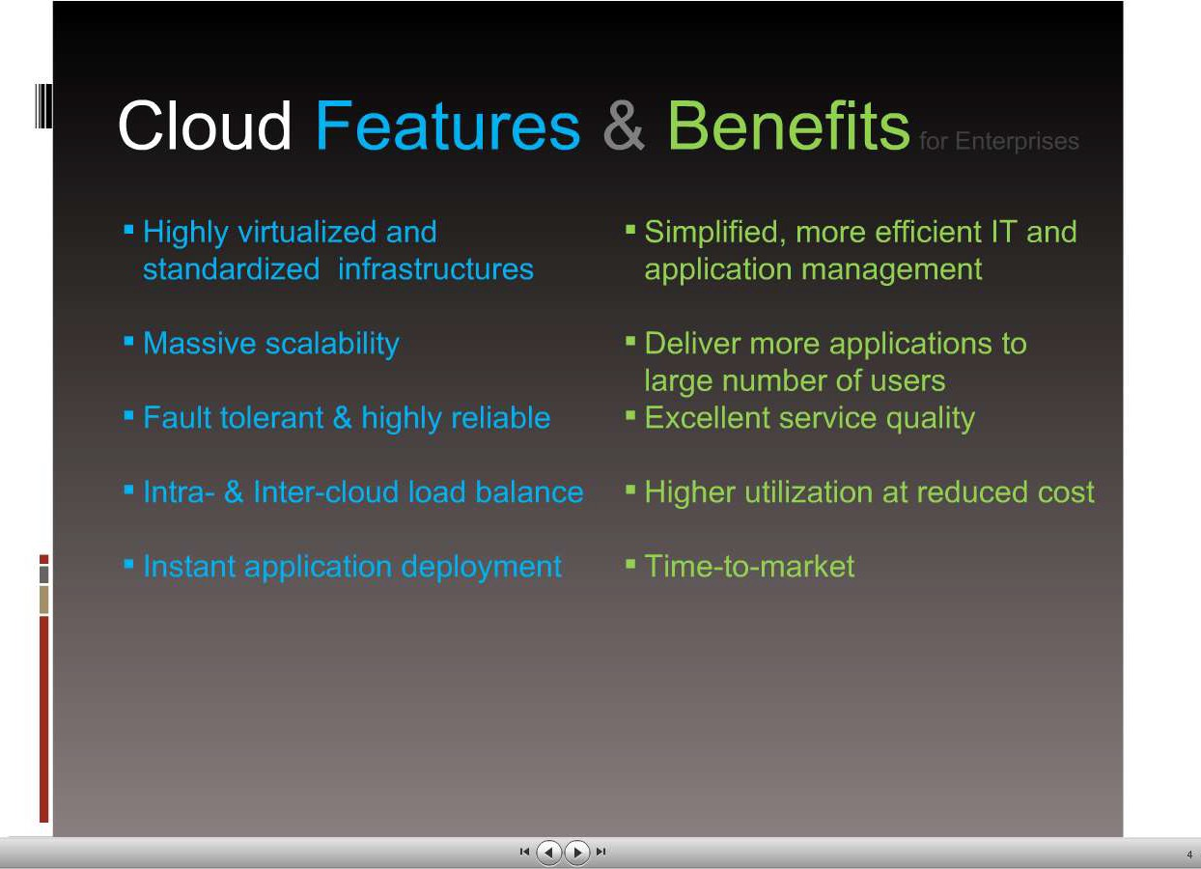
7/2/2021
Ashok kumar, CSE

Slide 40
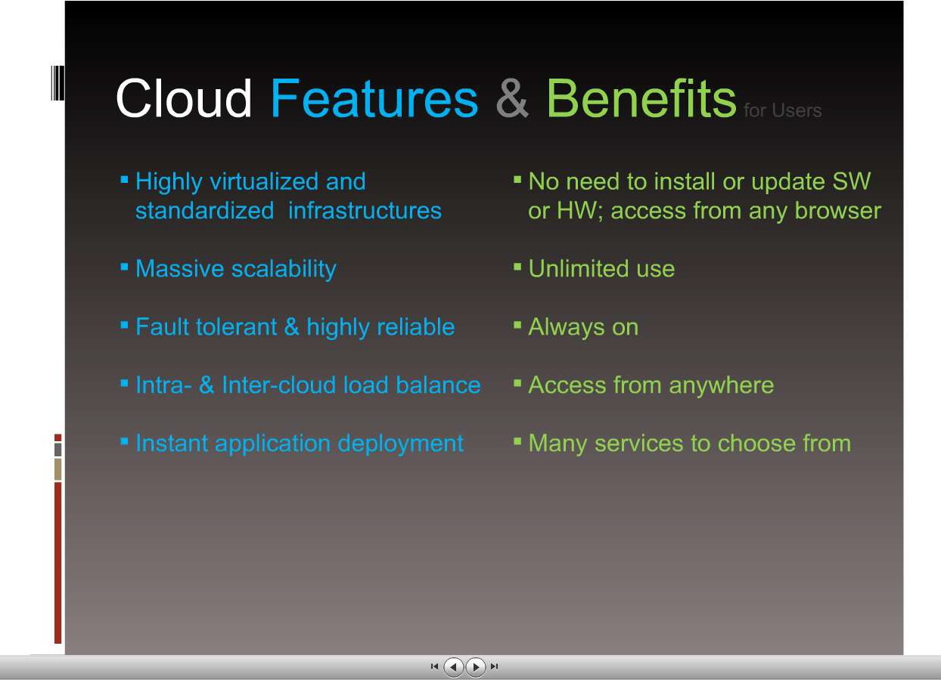
7/2/2021
Ashok kumar, CSE

Slide 41
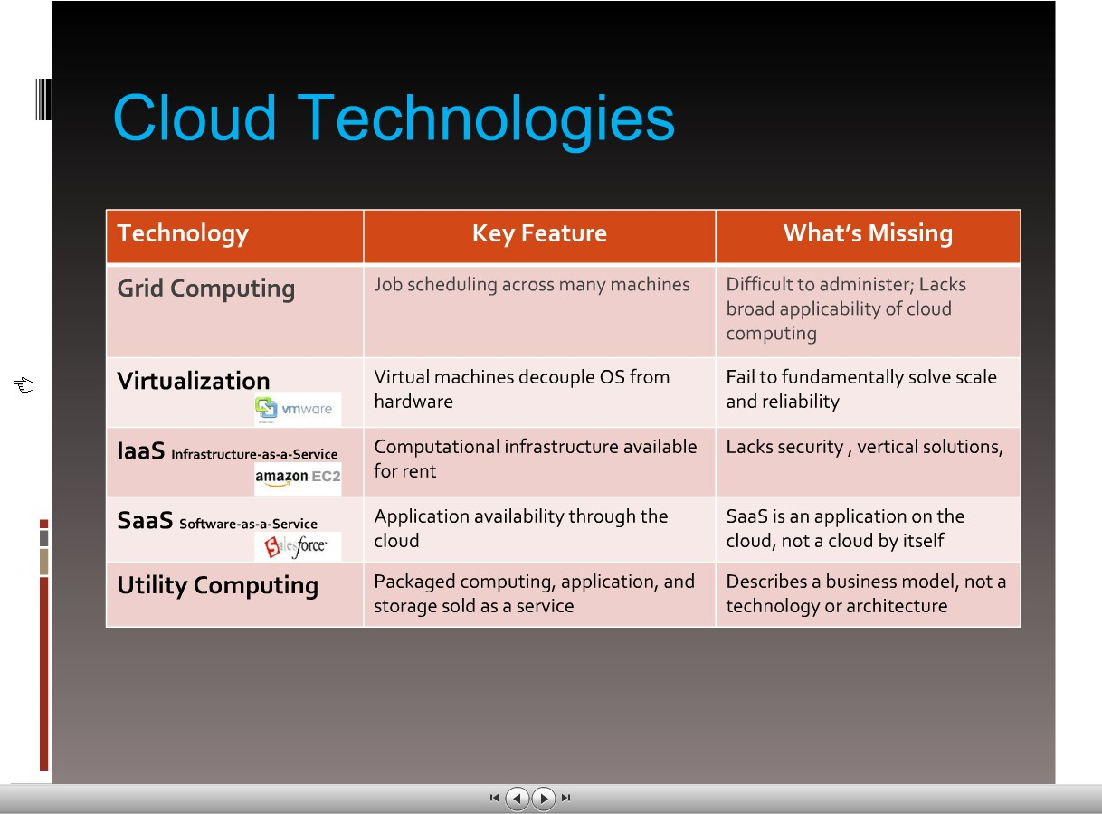
http://www.slideshare.net/andyandrews/cloud-computing-ppt
7/2/2021
Ashok kumar, CSE

Slide 42
Types of cloud:
Public Cloud
Private Cloud
Hybrid Cloud

Slide 43
Public Cloud
Public cloud allows the accessibility of systems and services easily to general public. Eg: Amazon, IBM, Microsoft, Google, Rackspace etc.

Slide 44
Advantages of Public Cloud Model
Low Cost
Reliable
Flexible
Location Independent
High Scalability

Slide 45
Disadvantages of Public Cloud Model
Low security
In public cloud model, data is present off-site and resources are shared publicly. Hence it does not ensure the high level security.
Less customizable
It is less customizable than private cloud.

Slide 46
Private Cloud
The Private cloud allows the accessibility of systems and services within the organization. Private cloud is operated only within a particular organization. But it will be managed internally or by third party.

Slide 47
Advantages of Private Cloud Model
High security and privacy
- Private cloud resources are shared from distinct pool of resources and hence highly secured.
More Control
-Private clouds resources and
have more control on its
hardware
accessed only within the
than public cloud
because it is
boundary of an organization.

Slide 48
Disadvantages of Private Cloud Model
Restriction
-Private cloud is only accessible locally and it is very difficult to deploy globally.
More Cost
- Private cloud is having more cost than public clouds.
Inflexible price
- In order to fulfill demands, purchasing new hardware is very costly.
Less Scalability
- Private clouds are scaled only within capacity of internal hosted resources.

Slide 49
Hybrid Cloud
The Hybrid cloud is the mixture of public and private cloud. Non-critical activities are performed by public cloud while critical activities are performed by private cloud.

Slide 50
Advantages of Hybrid Cloud Model
Scalable
-It provides both the features of public and private cloud scalability.
Flexible and secure
- It provides secure resources because of private cloud and scalable resources because of public cloud.

Slide 51
Advantages of Hybrid Cloud Model
Cost effective
- It is having less cost as compared to private cloud.

Slide 52
Disadvantages of Hybrid Cloud Model
Networking issues
Networking becomes complex because of private and public cloud.
Security Compliance
It is necessary to ensure that cloud services are compliant with the security policies of an organization.

Slide 53
PROS AND CONS OF CLOUD COMPUTING:
Advantages of Cloud Computing
There are various advantages of cloud computing technology. The important advantages of cloud computing are given below.
Lower cost computer for users
Lower IT infrastructure cost
Fewer maintenance cost
Lower Software Cost
Instant software updates
Increased computing Power
Unlimited storage capacity

Slide 54
PROS AND CONS OF CLOUD COMPUTING:
Disadvantages of Cloud Computing
There are various disadvantages of cloud computing technology. The important disadvantages of cloud computing are given below.
Require a constant Internet Connection
Require High Speed Internet connection
Stored Data Might Not Be Secure

Slide 55
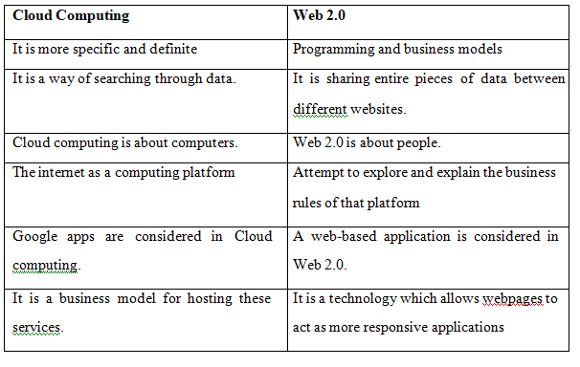
Difference: Cloud and Web 2.0

Slide 56
Key challenges in cloud computing
There are also many challenges involved in cloud computing, and if you’re not prepared to deal with them, you won’t realize the benefits. Here are six common challenges you must consider before implementing cloud computing technology.

Slide 57
Key challenges in cloud computing
Cost
Service Provider Reliability
Downtime
Password Security
Data privacy
Vendor lock-in

Slide 58
Key challenges in cloud computing
Cost
Cloud computing itself is affordable, but tuning the platform according to the company’s needs can be expensive. Furthermore, the expense of transferring the data to public clouds can prove to be a problem for short-lived and small-scale projects.
Companies can save some money on system maintenance, management, and acquisitions. But they also have to invest in additional bandwidth, and the absence of routine control in an infinitely scalable computing platform can increase costs.

Slide 59
Key challenges in cloud computing
Service Provider Reliability
The capacity and capability of a technical service provider are as important as price. The service provider must be available when you need them. The main concern should be the service provider’s sustainability and reputation. Make sure you comprehend the techniques via which a provider observes its services and defends dependability claims.

Slide 60
Key challenges in cloud computing
Downtime
Downtime is a significant shortcoming of cloud technology. No seller can promise a platform that is free of possible downtime. Cloud technology makes small companies reliant on their connectivity, so companies with an untrustworthy internet connection probably want to think twice before adopting cloud computing.

Slide 61
Key challenges in cloud computing
Password Security
Industrious password supervision plays a vital role in cloud security. However, the more people you have accessing your cloud account, the less secure it is. Anybody aware of your passwords will be able to access the information you store there.
Businesses should employ multi-factor authentication and make sure that passwords are protected and altered regularly, particularly when staff members leave. Access rights related to passwords and usernames should only be allocated to those who require them.

Slide 62
Key challenges in cloud computing
Data privacy
Sensitive and personal information that is kept in the cloud should be defined as being for internal use only, not to be shared with third parties. Businesses must have a plan to securely and efficiently manage the data they gather.

Slide 63
Key challenges in cloud computing
Vendor lock-in
Entering a cloud computing agreement is easier than leaving it. “Vendor lock-in” happens when altering providers is either excessively expensive or just not possible. It could be that the service is nonstandard or that there is no viable vendor substitute.
It comes down to buyer carefulness. Guarantee the services you involve are typical and transportable to other providers, and above all, understand the requirements.
Cloud computing is a good solution for many businesses, but it’s important to know what you’re getting into. Having plans to address these six prominent challenges first will help ensure a successful experience.

Slide 64
Cloud players
Top 5 cloud players
#1 Microsoft
#2 Amazon
#3 IBM
#4 Salesforce.com
#5 SAP

Slide 65
Deployment Models
Public Cloud
Private Cloud
Hybrid Cloud
Community Cloud

Slide 66
Public Cloud
Public Cloud is a type of cloud hosting that allows the accessibility of systems & its services to its clients/users easily. Some of the examples of those companies which provide public cloud facilities are IBM, Google, Amazon, Microsoft, etc
Public cloud is better suited for business purposes for managing the load. This type of cloud is economical due to the decrease in capital overheads.

Slide 67
The advantages of the Public cloud are:
Flexible
Reliable
High Scalable
Low cost
Place independence

Slide 68
Some Disadvantages
Less Secured
Poor Customizable

Slide 69
Private Cloud
Private Cloud also termed as 'Internal Cloud'; which allows the accessibility of systems and services within a specific boundary or organization. The cloud platform is implemented in a cloud-based secure environment that is guarded by advanced firewalls under the surveillance of the IT department that belongs to a particular organization. Private clouds permit only authorized users, providing the organizations greater control over data and its security. Business organizations that have dynamic, critical, secured, management demand based requirement should adopt Private Cloud.

Slide 70
The advantages of using private cloud are
Highly private and secured - Private cloud resource sharing is highly secured.
Control Oriented- Private clouds provide more control over its resources than public cloud as it can be accessed within the organization's boundary.

Slide 71
Disadvantages
Poor scalability - Private type of clouds is scaled within internal limited hosted resources.
Costly - As it provides secured and more features, so it's more expensive than a public cloud.
Pricing - is inflexible; i.e., purchasing new hardware for up-gradation is more costly.
Restriction - It can be accessed locally within an organization and is difficult to expose globally.

Slide 72
Hybrid Cloud
Hybrid Cloud is another cloud computing type, which is integrated, i.e., it can be a combination of two or more cloud servers, i.e., private, public or community combined as one architecture, but remain individual entities
Non-critical tasks such as development and test workloads can be done using public cloud whereas critical tasks that are sensitive such as organization data handling are done using a private cloud. Benefits of both deployment models, as well as community deployment model, are possible in a hybrid cloud hosting

Slide 73
Advantages of Hybrid Cloud Computing are:
Flexible
Secure
Cost Effective
Rich Scalable

Slide 74
Disadvantages of Hybrid Cloud are:
Complex networking problem
Organization's security Compliance

Slide 75
Community Cloud
It is another type of cloud computing in which the setup of the cloud is shared manually among different organizations that belong to the same community or area. Example of such a community is where organizations/firms are there along with the financial institutions/banks. A multi-tenant setup developed using cloud among different organizations that belong to a particular community or group having similar computing concern.

Slide 76
Virtualization
The term 'Virtualization' can be used in many respect of computer. It is the process of creating a virtual environment of something which may include hardware platforms, storage devices, OS, network resources, etc.
Virtualization is the ability which allows sharing the physical instance of a single application or resource among multiple organizations or users. This technique is done by assigning a name logically to all those physical resources & provides a pointer to those physical resources based on demand.
Over an existing operating system & hardware, we generally create a virtual machine which and above it we run other operating systems or applications. This is called Hardware Virtualization. The virtual machine provides a separate environment that is logically distinct from its underlying hardware. Here, the system or the machine is the host & virtual machine is the guest machine. This virtual environment is managed by a firmware which is termed as a hypervisor.

Slide 77
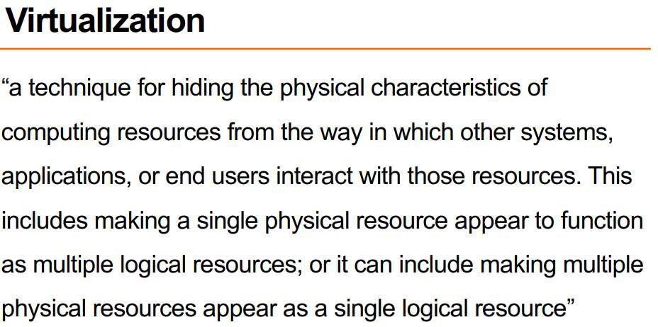

Slide 78
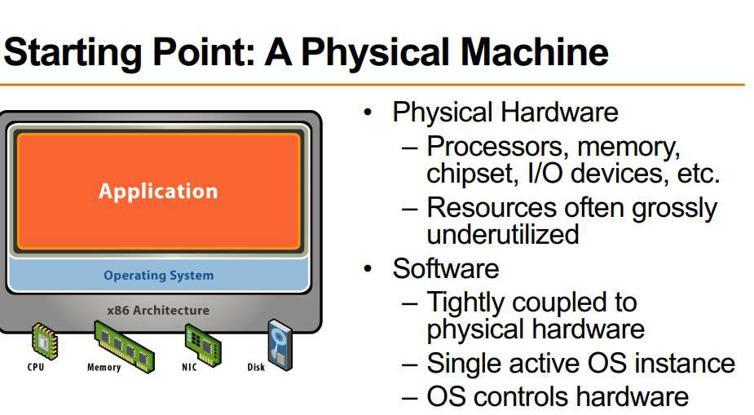

Slide 79
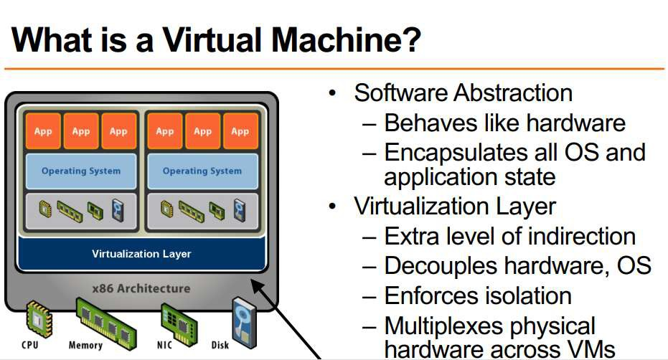

Slide 80
Approaches or ways to virtualizes cloud servers.
Grid Approach
OS - Level Virtualization
Hypervisor-based Virtualization
Software virtualization
Hardware virtualization
Server virtualization

Slide 81
Virtualization
Grid Approach - where the processing workloads are distributed among different physical servers, and their results are then collected as one.
OS - Level Virtualization -Here, multiple instances of an application can run in an isolated form on a single OS
Hypervisor-based Virtualization-With hypervisor's virtualization, there are various sub- approaches to fulfill the goal to run multiple applications & other loads on a single physical host

Slide 82
Virtualization
Hardware Virtualization -It is the abstraction of computing resources from the software that uses cloud resources. It involves embedding virtual machine software into the server's hardware components. That software is called the hypervisor.

Slide 83
Virtualization
Three types of hardware virtualizations
Full Virtualization - Here the hardware architecture is completely simulated. Guest software doesn't need any modification to run any applications
Emulation Virtualization - Here the virtual machine simulates the hardware & is independent. Furthermore, the guest OS doesn't require any modification
Para-Virtualization - Here, the hardware is not simulated; instead the guest software runs its isolated system

Slide 84
Software virtualization
It is also called application virtualization
Software virtualization is similar to that of virtualization except that it is capable to abstract the software installation procedure and create virtual software installation. Many applications & their distributions became typical tasks for IT firms and departments. The mechanism for installing an application differs.
So virtualized software is introduced in which an application that will be installed into its self-contained unit and provide software virtualization. Some of the examples are Virtual Box, VMware, etc
Benefits are Ease of Client Deployment , Software Migration, Easy to Manage

Slide 85
Server virtualization:
In this process, the server resources are kept hidden from the user. This partitioning of physical server into several virtual environments; result in the dedication of one server to perform a single application or task.
This technique is mainly used in web-servers which reduces the cost of web-hosting services. Instead of having separate system for each web-server, multiple virtual servers can run on the same system/computer.

Slide 86
Primary uses of server virtualization are:
To centralize the server administration
Improve the availability of server
Helps in disaster recovery
Ease in development & testing
Make efficient use of server resources.

Slide 87
Cloud resource management
Critical function of any man-made system.
It affects the three basic criteria for the evaluation of a system like:
Functionality.
Performance.
Cost.

Slide 88
Scheduling
Scheduling in a computing system deciding how to allocate resources of a system, such as CPU cycles, memory, secondary storage space, I/O and network bandwidth, between users and tasks.
Policies and mechanisms for resource allocation.
Policy: principles guiding decisions.
Mechanisms: the means to implement policies

Slide 89
Cloud resource management (CRM) policies
1. Admission control: prevent the system from accepting workload in violation of high-level system policies.
•
2. Capacity allocation: allocate resources for
individual activations of a service.
3. Load balancing: distribute the workload evenly among the servers
4. Energy optimization: minimization of energy consumption
5. Quality of service (QoS) guarantees: ability to satisfy timing or other conditions specified by a Service Level Agreement

Slide 90
Dynamic resource allocation
Cloud Computing environment can supply of computing resources on the basis of demand and when needed
Managing the customer demand creates the challenges of on-demand resource allocation.
Effective and dynamic utilization of the resources in cloud can help to balance the load and avoid
situations like slow run of systems.
Cloud computing allows business outcomes to scale up and down their resources based on needs.
Virtual Machines are allocated to the user based on their job in order to reduce the number of
physical servers in the cloud environment
If the VM is available then job is allowed to run on the VM.
If the VM is not available then the algorithm finds a low priority job taking into account the job’s lease type.

Slide 91
There are three types
Cancellable: These requests can be scheduled at any time after their arrival time
Suspendable: Suspendable leases are flexible in start time and can be scheduled at any time after their ready time
Non-Preemptable: The leases associated with such requests cannot be pre-empted at all.

Slide 92
Optimal allocation of cloud models
The optimal allocation of computing resources is a core part for implementing cloud computing.
High heterogeneity, high dynamism, and virtualization make the optimal allocation problem more complex than the traditional scheduling problems in grid system or cloud computing system.

Slide 93
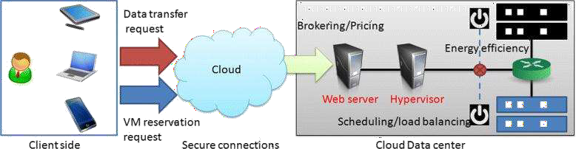
Optimal allocation of cloud models

Slide 94
Quiz
https://forms.gle/yCP92iUP4D2nFjaK6

Slide 95
UNIT II
CLOUD SERVICE MODELS

Slide 96
UNIT 2 CLOUD SERVICE MODELS :
Software as a Service (SaaS) - Infrastructure as a Service (IaaS)- Platform as a Service (PaaS)- Service Oriented Architecture (SoA) - Elastic Computing - On Demand Computing.

Slide 97
Software-as–a-Service (SaaS)
Software-as–a-Service (SaaS) model allows to provide software application as a service to the end users. It refers to a software that is deployed on a host service and is accessible via Internet. There are several SaaS applications listed below:
Billing and invoicing system
Customer Relationship Management (CRM) applications
Help desk applications
Human Resource (HR) solutions

Slide 98
Characteristics
Here are the characteristics of SaaS service model:
SaaS makes the software available over the Internet.
The software applications are maintained by the vendor.
The license to the software may be subscription based or usage
based. And it is billed on recurring basis.
SaaS applications are cost-effective since they do not require any
maintenance at end user side.
They are available on demand.
They can be scaled up or down on demand.
They are automatically upgraded and updated.
SaaS offers shared data model. Therefore, multiple users can share single instance of infrastructure. It is not required to hard code the functionality for individual users.
All users run the same version of the software.

Slide 99
Benefits of SaaS
Using SaaS has proved to be beneficial in terms of scalability, efficiency and performance.
Some of the benefits are listed below:
Modest software tools
Efficient use of software licenses
Centralized management and data
Platform responsibilities managed by provider
Multitenant solutions

